Slide 1

KADJEBI DISTRICT ASSEMBLY
2020 COMPOSITE BUDGET HEARING
PRESENTATION
Prepared by:
Budget Committee
Kadjebi District Assembly

Slide 2
INTRODUCTION
Establishment
Kadjebi District was created as an Assembly by legislative Instrument (L.I.) 1465 in 1989 with Kadjebi as the district capital.
The District forms part of the newly created Oti Region.
Population
The total projected population for 2021 is 76,293.
38,528 (50.5%) males
37,765 (49.5%) females.
The population growth rate 4.9% as compared with the growth rate of 2.7% for the nation.
DISTRICT ECONOMY
Agriculture
These crops are cultivated: cassava, yams, cocoyam, plantain, maize, cocoa, rice, ginger and oil palm.
62.5 percent of the economically active population is engaged in agriculture (2010 Population and Housing Census)

Slide 3
DISTRICT ECONOMY CONT.
Road
Kadjebi District has a total road network of 290kms, a quarter of this number is tarred and the rest are routinely maintained.
Health
There are Twenty-Five (25) health facilities in the district, consisting of:
One Hospital (mission),
Five Health Centers,
Eighteen CHPS zones
One Private maternity home.
Education
The district has the following school levels:

Slide 4
SCHOOL | PUBLIC | PRIVATE | TOTAL
Kindergarten | 71 | 21 | 92
Primary | 69 | 20 | 89
Junior Secondary | 46 | 12 | 58
Senior Secondary | 3 | 0 | 3
Environment
Average monthly temperature of about 25ºC and rainfall is between 1400 mm and 1800mm. Rainfall is generally heavy and starts from March and ends between October and November each year. The peak of rainfall occurs in June.

Slide 5
DISTRICT ECONOMY CONT.
Financial Institutions
The Ghana Commercial Bank operates at Kadjebi.
The North Volta Rural Bank agency at Kadjebi and Dodi Papase .
Credit unions and microfinance institutions like Dalex Finance.
Sanitation
District Environmental Health Unit survey in 2016
60.5% of households dispose of Solid Waste at public dumps
30.5% of households dump solid waste indiscriminately.

Slide 6
Industry
The industry setup of the district is mainly in the area of Agro-Processing , Forest/Wood Processing, metal Industry and Auto Works, Handy Craft/Art based industry and Palm oil production.
Tourism Potentials
Kadjebi district has a number of sites of historical, cultural, scenic and ecological importance for the promotion of tourism which the district is yet to develop.
These include: -
Stone Pillar at Nyonku No. 1, 3km North-East of Dodi-Papase
Stone cave which is found at Bakpa, 6.5km West of Papase
Obuletey cave which is located in the Asato Menu Range Hills and 7km North-East of Asato
Embroiled Inscription on a rock found at Butabe
Cultural Groups such as Adowa, Ositi, Kete, Apentem, Akomfode, Borborbor, Agbadza, Chorals, Drum language, Akaye Group Asadua.
Traditional festivals like Dawurokese and Kwasidakese

Slide 7
KEY DEVELOPMENT ISSUES/CHALLENGES
Key issues identified are as follows:
Poor road network
Inadequate office and residential accommodation facilities for staff
Low agriculture production leading to low income levels
Over dependence on rain fed agriculture
Falling standards of education
Inadequate staff and logistics
High rate of unemployment
Teenage pregnancy
Lack of storage facility leading to post harvest loss
The district is faced with perennial bushfires

Slide 8
VISION STATEMENT
To become the best managed assembly that creates opportunities for human and natural resources development in Ghana
MISSION STATEMENT
The Kadjebi District Assembly exists to improve on the socio-economic well–being of her people through the provision of basic social services and the promotion of sustainable resource development within the context of governance
CORE VALUES
Accountability, Client-oriented, Creativity, Diligence, Discipline, Equity, Integrity, Innovativeness, Timeliness, and Transparency

Slide 9
CORE FUNCTIONS OF THE ASSEMBLY
The Kadjebi District Assembly performs a number of functions as stipulated by the Local Governance Act 2016 (936) and other legal documents. The Assembly is responsible for the overall development of the district and shall ensure the preparation and submission through the Regional Co-Ordinating Council
Development plans of the district to the National Development Planning Commission for approval,
The budget of the district related to the approved plans to the Minister responsible for Finance for approval;
Shall formulate and execute plans, programmes, and strategies for the effective mobilization of the resources necessary for the overall development of the district;
Shall promote and support productive activity and social development in the district and remove any obstacles to initiative and development;
Shall initiate programmes for the development of basic infrastructure and provide municipal works and services in the district;
Is responsible for the development, improvement, and management of human settlements and the environment in the district;
Is responsible in co-operation with the appropriate national and local security agencies, for the maintenance of security and public safety in the district;
Shall ensure ready access to Courts in the district for the promotion of justice;
Shall initiate, sponsor or carry out studies that are necessary for the performance of a function conferred by this Act or by any other enactment;
Perform any other functions provided for under any other enactment

Slide 10
FINANCIAL PERFORMANCE-REVENUE
REVENUE PERFORMANCE- ALL REVENUE SOURCES
ITEM | 2018 |  | 2019 |  | 2020 |  | % performance at Aug., 2020
 | Budget | Actual | Budget | Actual | Budget | Actual as at Aug.
IGF | 386,090.00 | 208,008.26 | 321,300.00 | 247,699.76 | 302,220.00 | 180,821.00 | 59.83
Compensation Transfer | 1,567,780.00 | 1,437,131.65 | 1,380,457.05 | 1,380,458.01 | 1,270,123.06 | 846,748.67 | 66.67
Goods and Services Transfer | 60,966.66 | 147,646.01 | 55,486.37 | 7,632.85 | 71,323.72 | 46,646.20 | 65.40
Ghana Gas (Energy Fund) | - | - | - | - | 150,000.00 | 150,000.00 | 100.00
DACF | 3,075,722.00 | 1,409,102.17 | 4,153,240.67 | 1,747,654.50 | 4,038,890.64 | 899,888.28 | 22.28
DDF | 486,838.00 | 366,186.00 | 785,120.07 | 692,369.91 | 744,420.33 | 542,047.08 | 72.81
DACF MP | 230,679.15 | 312,132.16 | 627,356.69 | 328,635.60 | 583,141.88 | 254,092.00 | 43.57
World Bank (Safety Net) | - | - | 520,885.57 | - | 216,265.41 | 176,520.00 | 81.62
DACF PWD | 62,769.84 | 258,071.32 | 400,000.00 | 202,669.77 | 400,000.00 | 260,827.90 | 65.21
Donor-UNICEF and WV | 171,282.00 | 31,645.97 | 171,282.00 | 116,196.00 | 162,000.00 | 0.00 | 0.00
Donor-CIDA | 72,784.03 | 72,784.03 | 151,541.00 | 151,541.21 | 162,712.58 | 113,898.81 | 70.00
Total | 6,114,911.68 | 4,242,707.57 | 8,566,669.42 | 4,874,857.61 | 8,101,097.62 | 3,471,489.94 | 42.85

Slide 11
The performance of total revenue as at August 2020 was GH¢3,471,489.94 against budgeted estimate of GH¢8,101,097.62 representing 42.85%.
The low performance of total revenue as against budget estimates can hugely be attributed to untimely releases of funds from Government, specifically DACF and other developmental partners.

Slide 12
FINANCIAL PERFORMANCE-REVENUE
REVENUE PERFORMANCE- IGF ONLY
ITEM | 2018 |  | 2019 |  | 2020 |  | % performance as at Aug.,2020
 | Budget | Actual | Budget | Actual | Budget | Actual as at Aug.
Property Rate | 32,000.00 | 47,086.96 | 32,000.00 | 53,651.03 | 50,000.00 | 36,362.00 | 72.7
Fees | 130,200.00 | 96,415.00 | 130,200.00 | 128,905.83 | 143,220.00 | 67,993.00 | 47.5
Fines | 1,000.00 | 1,020.00 | 1,500.00 | 9,003.00 | 5,000.00 | 5,712.00 | 114.2
Licenses | 45,890.00 | 38,480.20 | 83,752.00 | 36,384.40 | 60,000.00 | 22,553.00 | 37.6
Land | 60,000.00 | 7,986.10 | 44,000.00 | 13,519.50 | 15,000.00 | 25,821.00 | 172.1
Rent | 5,000.00 | 2,560.00 | 26,848.00 | 6,236.00 | 26,000.00 | 22,380.00 | 86.1
Investment | 110,000.00 | 13,000.00 | 3,000.00 | - | 3,000.00 | - | -
Miscellaneous | 2,000.00 | 1,460.00 | 0.00 | - | - | - | -
Total | 386,090.00 | 208,008.26 | 321,300.00 | 247,699.76 | 302,220.00 | 180,821.00 | 59.8

Slide 13
From the table above, IGF performance as at August 2020 was GH¢180,821.00 against budgeted estimate of GH¢302,220.00 representing 59.83%. The IGF performance is on truck to be achieved by the end of the year and this is due to commitment by management to raising the IGF collection in spite of COVID-19 pandemic.
Fees and Licenses are not performing well because of the effect of the COVID-19 pandemic. Fees and Licenses saw only 47.5% and 37.6% collection rate respectively.
Investment for the year is nil as against previous years. This is due to grounding of the Assembly’s grader and cesspit emptier.

Slide 14
FINANCIAL PERFORMANCE-EXPENDITURE
EXPENDITURE PERFORMANCE (ALL DEPARTMENTS) GOG ONLY
Expenditure | 2018 |  | 2019 |  | 2020
 | Budget | Actual | Budget | Actual | Budget | Actual as at Aug. | % Performance (as at Aug. 2020)
Compensation | 1,567,780.00 | 1,437,131.65 | 1,380,457.05 | 1,380,457.05 | 1,270,123.00 | 846,748.67 | 66.67
Goods and Services | 60,966.66 | 151,202.14 | 55,486.37 | 55,486.37 | 71,323.72 | - | -
Assets | - | - | - | - | - | - | -
Total | 1,628,746.66 | 1,588,333.79 | 1,435,943.42 | 1,435,943.42 | 1,341,446.72 | 846,748.67 | 63.12

Slide 15
FINANCIAL PERFORMANCE-EXPENDITURE
EXPENDITURE PERFORMANCE (ALL DEPARTMENTS) IGF ONLY
Expenditure | 2018 |  | 2019 |  | 2020
 | Budget | Actual | Budget | Actual | Budget | Actual as at Aug. | % age Performance (as at Aug. 2020)
Compensation | 67,600.00 | 90,284.55 | 105,780.00 | 65,365.29 | 28,200.00 | 6,290.26 | 22.3
Goods and Services | 241,272.00 | 117,529.17 | 180,460.00 | 180,460.00 | 213,576.00 | 115,779.04 | 54.2
Assets | 77,218.00 | - | 35,060.00 | 28,310.29 | 60,444.00 | 48,000.00 | 79.4
Total | 386,090.00 | 207,813.72 | 321,300.00 | 274,135.58 | 302,220.00 | 170,069.30 | 56.3

Slide 16
Despite the effect of COVID-19 pandemic on fiscal decisions of Assemblies, the Assembly was able to channeled 28.2% of it IGF expenditure towards the construction of 2No.Market sheds at Papase.

Slide 17
FINANCIAL PERFORMANCE-EXPENDITURE
EXPENDITURE PERFORMANCE (ALL DEPARTMENTS) ALL FUNDING SOURCES
Expenditure | 2018 |  | 2019 |  | 2020
 | Budget | Actual | Budget | Actual | Budget | Actual as at Aug. | % age Performance (as at Aug. 2020)
Compensation | 1,567,780.00 | 1,437,131.65 | 1,512,238 | 1,447,823.30 | 1,298,323.06 | 853,038.93 | 65.7
Goods and Services | 2,179,532.53 | 1,198,405.70 | 2,571,212.78 | 1,521,883.95 | 2,955,917.34 | 1,710,178.49 | 57.86
Assets | 2,367,599.15 | 1,498,016.68 | 3,753,626.00 | 1,418,648.91 | 3,876,857.22 | 1,058,962.67 | 27.3
Total | 6,114,911.68 | 4,133,554.03 | 7,837,076.78, | 4,388,356.16 | 8,101,097.62 | 3,622,180.09 | 44.7

Slide 18
NON FINANCIAL PERFORMANCE BY PROGRAMMES

Slide 19
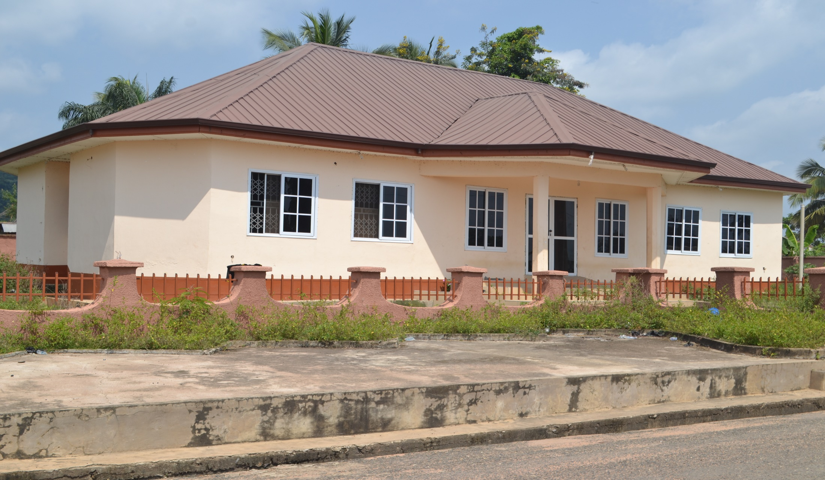
Key Achievements (2020)
1. Rehabilitation of Kadjebi Community Library (Completed and from DACF)

Slide 20
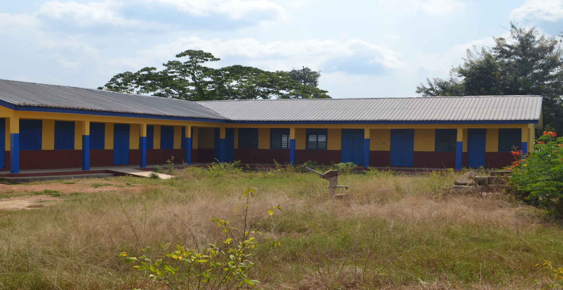
2. Construction of 1No. 3-unit classroom block at Kadjebi D.A Primary B (completed and from DACF)

Slide 21
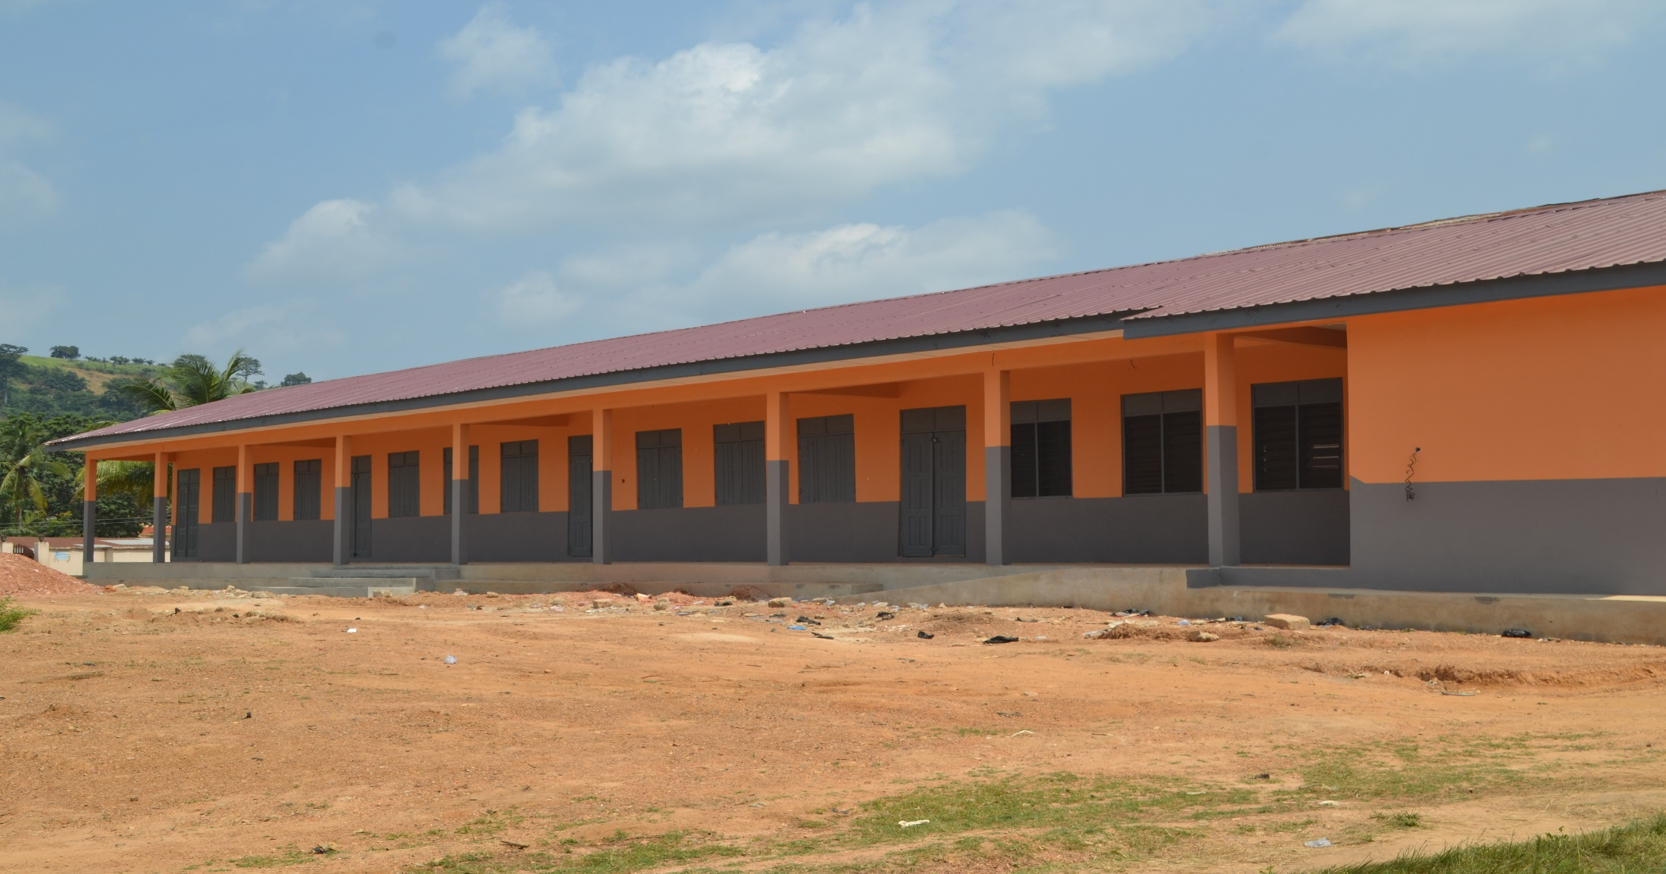
3. Construction of 1No. 3-Unit Classroom Block at Kadjebi E.P JHS (Completed and from DACF-RFG)

Slide 22
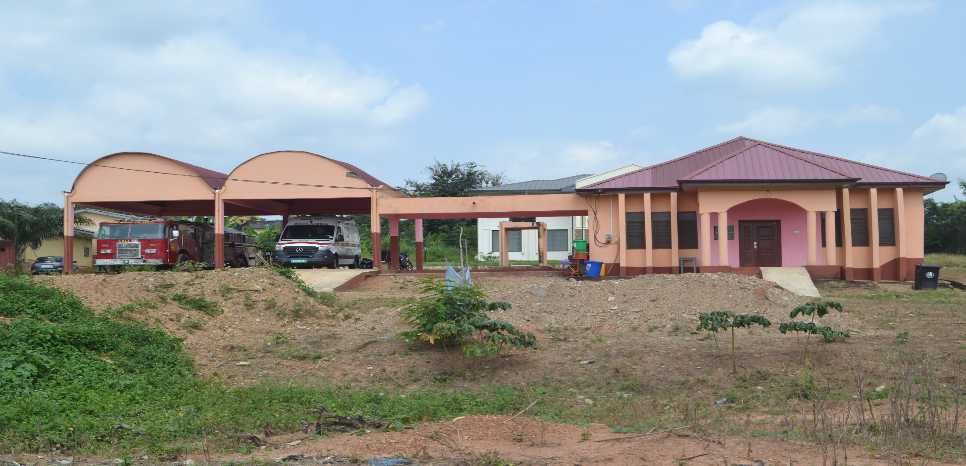
4.Construction of Fire/Ambulance Bay (completed and from DDF)

Slide 23
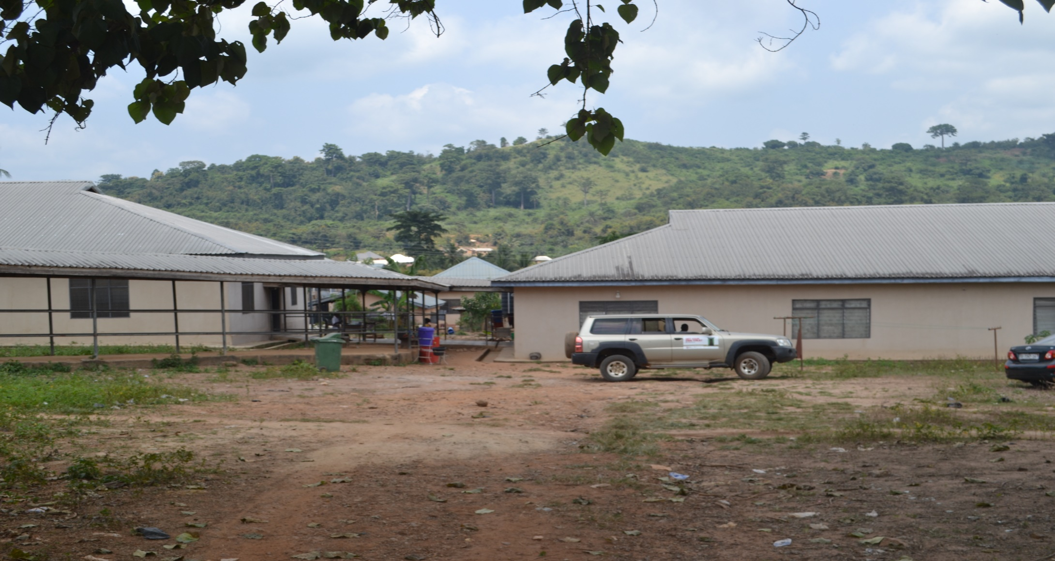
5. Completion of ward l and ll (Complete and from DACF-RFG

Slide 24
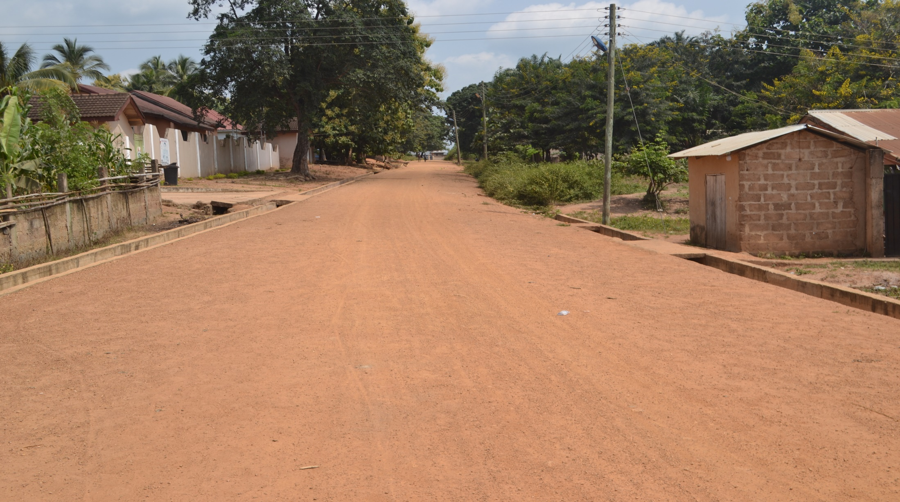
6. Spot improvement of 0.7km EP JHS to RC School road
(Complete and from DACF-RFG)

Slide 25
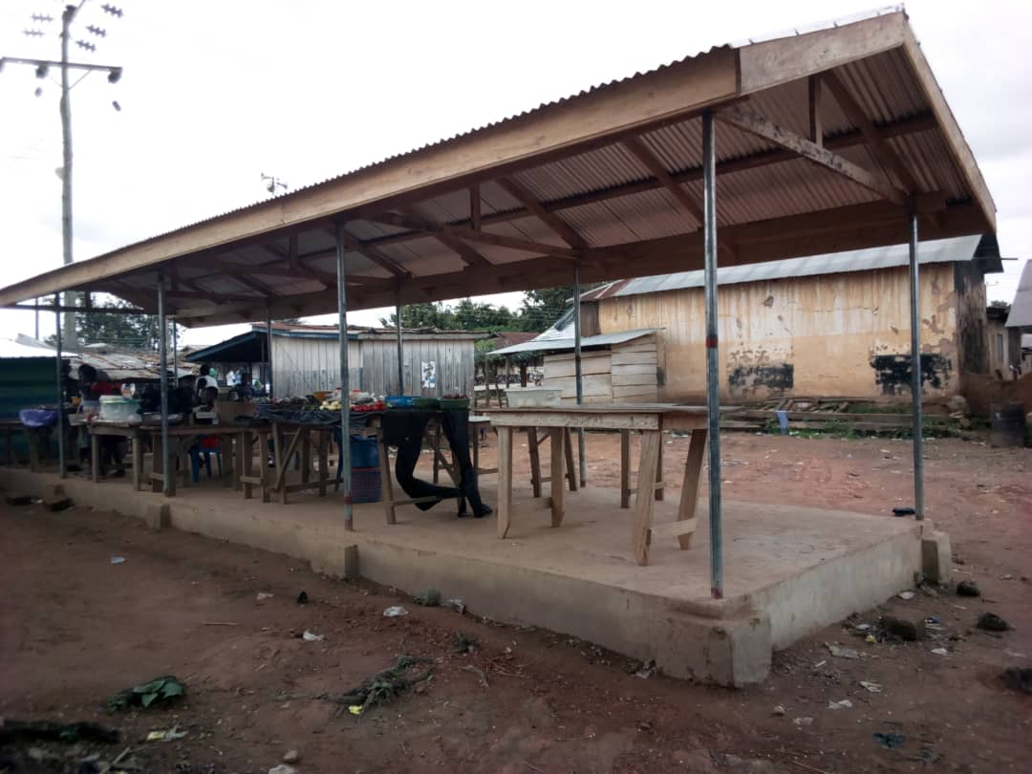
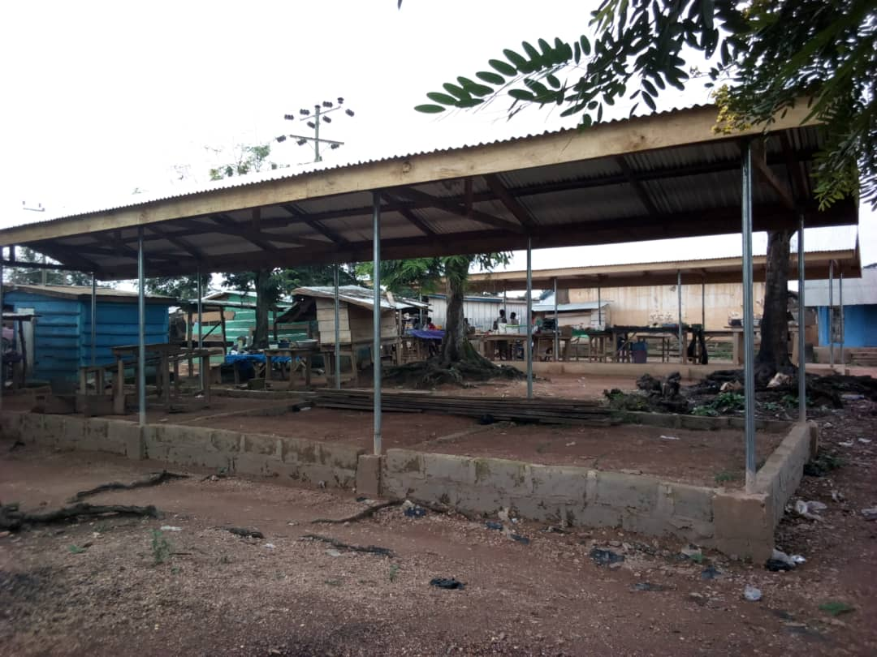
7. Construction of 2No. 12 rooms each market sheds at Papase (90% complete and from IGF)

Slide 26
Policy Outcome Indicators and Targets
Outcome Indicator Description | Unit of Measurement | Baseline |  | Actual Performance
 |  | Year 2019 | Value | Target For the Year 2020 | Actuals as at Aug.
Teaching and learning enhanced | BECE Performance (% passed) | 42 | 42 | 60 | Not yet
 | No. of school buildings constructed | 1 | 1 | 4 | 3
Agricultural Development | No. of tubers of market oriented ginger (Peruvian variety) introduced | - | - | - | -
 | % increase in Rice production | 6 | 9 | 10 | 9.4

Slide 27
Policy Outcome Indicators and Targets
Outcome Indicator Description | Unit of Measurement | Baseline |  | Actual Performance
 |  | Year 2019 | Value | Target For the Year 2020 | Actuals as at Aug.
Access to Health Services improved | OPD attendance | 76,000 | 75,281 | 76,466 | 30,760
 | No. of functional CHPS/Health Centres constructed | 1 | 1 | 1 | 1
Child Rights improved | No. of child maintenance cases reported and resolved | 10 | 9 | 10 | 4
 | No. of sensitization activities held | 11 | 11 | 8 | 2

Slide 28
Policy Outcome Indicators and Targets
Outcome Indicator Description | Unit of Measurement | Baseline |  | Actual Performance
 |  | Year 2019 | Value | Target For the Year 2020 | Actuals as at Aug.
Increased access to social intervention programmes | No. of PWD beneficiaries | 90 | 80 | 90 | 85
 | No. of LEAP beneficiaries | 6544 | 6544 | 6595 | 6544
IGF Mobilisation enhanced | % rate of IGF collection | 100 | 77.09 | 100 | 59.83
Improved transport infrastructure services | Km of roads reshaped/Spot improved | 10 | 20 | 40 | 15

Slide 29
Policy Outcome Indicators and Targets
Outcome Indicator Description | Unit of Measurement | Baseline |  | Actual Performance
 |  | Year 2019 | Value | Target For the Year 2020 | Actuals as at Aug.
Improved local participation in governance | No.of Town Hall meetings held | 4 | 4 | 4 | 2
 | No.of General Assembly meetings held | 3 | 3 | 3 | 2
Water and sanitation improved | No. of Boreholes drilled/repaired | 20 | 15 | 20 | 20
 | % increase in sanitation coverage (ODF) | 59.70 | 31.8 | 74.6 | 10.3

Slide 30
Policy Outcome Indicators and Targets
Outcome Indicator Description | Unit of Measurement | Baseline |  | Actual Performance
 |  | Year 2019 | Value | Target For the Year 2020 | Actuals as at Aug.
Increased adherence to spatial plans | No. of building permits issued | 50 | 34 | 50 | 33
 | No.of sensitisation programmes undertaken | 4 | 4 | 4 | 3
Disaster prevention and mitigation enhanced | No.of reported cases of disaster | 1 | 1 | 3 | 1
 | No.of sensitisation programmes held | 4 | 5 | 4 | 15

Slide 31
KEY PERFORMANCE INFORMATION FOR BUDGET PROGRAMMES
(Management and Administration)
Key/Main Outputs | Output Indicator | Past Years
 |  | 2019 Target | 2019 Actual | 2020 Target | 2020 Actual (as at August)
1. General Assembly Meetings Organised | No. of signed minutes on file | 3 | 3 | 3 | 2
2. HRMIS Returns/Reports | No. of validation | 12 | 12 | 12 | 8
3. Management meetings organised | No. of signed minutes on file | 4 | 4 | 4 | 3

Slide 32
KEY PERFORMANCE INFORMATION FOR BUDGET PROGRAMMES
(INFRASTRUCTURE DELIVERY AND MANAGEMENT )
Key/Main Outputs | Output Indicator | Past Years
 |  | 2019 Target | 2019 Actual | 2020 Target | 2020 Actual (as at August)
1. Planning education in communities organized | No. of meetings held with signed reports and invitation letter | 4 | 4 | 4 | 3
2. Technical Sub-Committee meetings held | Minutes of meetings signed and filed | 12 | 12 | 12 | 8

Slide 33
KEY PERFORMANCE INFORMATION FOR BUDGET PROGRAMMES
(SOCIAL SERVICES DELIVERY)
Key/Main Outputs | Output Indicator | Past Years
 |  | 2019 Target | 2019 Actual | 2020 Target | 2020 Actual (as at August)
1. STMIE clinics organised | No. of clinics organised | 1 | 1 | 1 | 0
2. Fund distributed to PWDs | No. of people benefitted from the fund | 90 | 80 | 90 | 85
3. Access to health service delivery improved | No. of functional health centres constructed | 2 | 1 | 1 | 1

Slide 34
KEY PERFORMANCE INFORMATION FOR BUDGET PROGRAMMES
(ECONOMIC DEVELOPMENT)
Key/Main Outputs | Output Indicator | Past Years
 |  | 2019 Target | 2019 Actual | 2020 Target | 2020 Actual (as at August)
1. Farm/home visits on extension services Attended | No. of farm/homes visited | 3840 | 3406 | 4224 | 1544
2. SMEs sub-committee meetings held | Number of SMEs sub-committee meetings held | 4 | 3 | 4 | 2

Slide 35
KEY PERFORMANCE INFORMATION FOR BUDGET PROGRAMMES
(ENVIRONMENTAL AND SANITATION MANAGEMENT)
Key/Main Outputs | Output Indicator | Past Years
 |  | 2019 Target | 2019 Actual | 2020 Target | 2020 Actual (as at August)
1. Disaster Reports prepared and submitted | No. Of Quarterly Reports | 4 | 4 | 4 | 3
 | Annual reports | 1 | 1 | 1 | 1

Slide 36
2020 Budget Programme Performance
Budget Programme | Budget | Actual as at August 2020
BP1: Management and Administration | 1,466,226.47 | 717,961.67
BP2: Infrastructure Development and Management | 1,500,301.68 | 495,442.87
BP3: Social Services Delivery | 3,504,309.80 | 2,034,296.60
BP4: Economic Development | 1,535,259.67 | 359,478.95
BP5: Environmental Management | 95,000.00 | 15,000.00
Total | 8,101,605.56 | 3,622,180.09

Slide 37
Financials
2020 Key projects and programmes from all sources
No | Name of project | Amount budgeted | Actual Payment as at August, 2020 | Outstanding payment
1 | Construction of District Police Headquarters (Phase l) | 549,755.50 | 97,581.50 | 452,174.00
2 | Rehabilitation of Residency Building (DCE’s Bungalow) | 102,519.18 | 88,301.74 | 14,217.44
3 | Rehabilitation of Kadjebi Community Library (ongoing) | 51,508.73 | 51,508.73 | -
4 | Construction of 1No. 3-unit Classroom Block, Library, Headmaster’s Office, Staff Common Room and it ancillary facilities at Kadjebi D.A Prim. B | 206,514.44 | 206,514.44 | -
5 | Construction of 1No. CHPS compound and its ancillary facilities at Menusu (ongoing) | 246,652.74 | 49,971.00 | 196,681.74

Slide 38
Financials
2020 Key projects and programmes from all sources
No | Name of project | Amount budgeted | Actual Payment as at August, 2020 | Outstanding payment
7 | Renovation of Dodo Amanfrom Health Centre and its ancillary facilities (ongoing) | 209,062.55 | 60,000.00 | 149,062.53
8 | Construction of 1no. 3-unit Classroom Block, Library, Headmaster's Office and staff common room at Kadjebi E/P Central J.H. | 380,000 | 249,482.25 | 130,517.75
9 | Drilling and mechanisation of 1No. Borehole at Dzindzisu market, extension of pipe water to Kadjebi market and lorry station, Ahamansu markets and provision of PPEs and veronica buckets | 166,280.62 | 166,247.56 | 33.06
10 | Rehabilitation and fencing of slaughter house at Kadjebi | 101,243.82 | 0.00 | 101,243.82
11 | Construction of 1No. 3 Unit Classroom Block, Library, Headmaster’s Office and Staff Common Room and provision of furniture to the classrooms at Okanta | 418,113.00 | 54,198.90 | 363,914.10

Slide 39
Financials
2020 Key projects and programmes from all sources
No | Name of project | Amount budgeted | Actual Payment as at August, 2020 | Outstanding payment
12 | Procurement of building materials to support disaster victims | 150,000.00 | 150,000.00 | 0.00
13 | Consultancy services for the extension and intensification of electricity supply to 29 communities in the district | 37,000.00 | 0.00 | 37,000.00
14 | Renovation of NADMO Office | 40,000.00 | 0.00 | 40,000.00
15 | Production and acquisition of improved agricultural inputs | 30,000.00 | 13,950.00 | 16,050.00
16 | Renovation of meat shop at Kadjebi market | 20,000.00 | 20,000.00 | 0.00

Slide 40
Financials
2020 Key projects and programmes from all sources
No | Name of project | Amount budgeted | Actual Payment as at August, 2020 | Outstanding payment
17 | Construction of 2No. 12 rooms market sheds at Papase | 60,444.00 | 48,000.00 | 12,444.00
18 | Reshaping of 40Km feeder roads | 190,000.00 | 100,000.00 | 90,000.00
19 | Development and promotion of Tourism potentials | 30,000.00 | 0.00 | 30,000.00
20 | Social intervention programmes (Support to PWDs) | 386,000.00 | 320,012.39 | 65,987.61
21 | Manpower and Skills development (PWD) | 14,000.00 | 8,300.00 | 5,700.00
22 | Liquid waste management (RBF and Fumigation) | 323,000.00 | 96,335.00 | 226,665.00
23 | Solid waste management (Landfill Sites management, SIP) | 220,200.00 | 85,100.00 | 135,100.00

Slide 41
Sanitation Budget Performance
Liquid Waste
No | Name of Activity/Project | Budget | Actual as at Aug., 20
1 | Community Led Total Sanitation (UNICEF WASH) | 162,000.00 | 15,835.00
2 | Fumigation | 161,000.00 | 80,500.00
Solid Waste
No | Name of Activity/Project | Budget | Actual as at Aug., 2020
1 | Sanitation Improvement Package (SIP) | 170,200.00 | 85,100.00
2 | Management of waste final disposal site by Landfills | 50,000.00 | -
3 | Environmental Sanitation Management | 35,000.00

Slide 42
DP Support- WASH
Environmental Sanitation Management
No | Name of Activity/Project | Budget | Actual as at Aug., 2020
 | Community Led Total Sanitation (Environmental Sanitation management) | 162,000.00 | 15,835.00

Slide 43
DP Support- Safety Net
Agricultural Development
No | Name of Activity/Project | Budget | Actual as at Aug., 2020
 | Agricultural Research and Demonstration Farms | 150,000.00 | 30,000.00

Slide 44
DP Support - MAG
Agricultural Development
No | Name of Activity/Project | Budget | Actual as at Aug., 2020
1 | Extension Services | 136,541.00 | 89,450.00
2 | Monitoring and evaluation of programmes and projects | 10,000.00 | 7,500.00
3 | Manpower And Skills Development | 5,000 | 5,000
 | Total | 151,541.00 | 101,950.00

Slide 45
Government Flagship Projects/Programmes
(Assembly’s Contribution)
No | Name of Activity/Project | Budget | Actual as at August, 2020
1 | Support the implementation of One District One factory policy of government
1a | Establish a 34,000 oil palm nursery | 30,000.00 | 13,950.00

Slide 46
OUTLOOK FOR 2021-2024

Slide 47
MMDA Adopted Policy Objectives for 2021
FOCUS AREA | POLICY OBJECTIVE | BUDGET ALLOCATION
GOOD GOVERNANCE | Improve decentralized planning | 155,000.00
 | Deepen political and administrative decentralization | 742,233.00
 | Ensure free, equitable and quality education for all by 2030 | 1,727,098.5
SOCIAL DEVELOPMENT | Achieve universal health coverage, including financial risk protection, access to quality health-care services. | 651,533.7
SOCIAL DEVELOPMENT CONT’D | Eradicate forced labour and end slavery | 30,503.00

Slide 48
MMDA Adopted Policy Objectives for 2021
FOCUS AREA | POLICY OBJECTIVE | BUDGET ALLOCATION
DISABILITY AND DEVELOPMENT | Ensure that PWDs enjoy all the benefits of Ghana citizenship | 405,200.00
ECONOMIC | Mobilise additional financial resources for development | 40,000.00
ECONOMIC | Improve business financing | 362,000.00
ECONOMIC | Improve production efficiency and yield | 297,500.00

Slide 49
MMDA Adopted Policy Objectives for 2021
FOCUS AREA | POLICY OBJECTIVE | BUDGET ALLOCATION
ENVIRONMENT, INFRASTRUCTURE AND HUMAN SETTLEMENT | Facilitate sustainable and resilient infrastructure development | 1,108,473.60
ENVIRONMENT, INFRASTRUCTURE AND HUMAN SETTLEMENT | Develop efficient land administration and management system | 264,868.00
DISASTER MANAGEMENT | Reduced vulnerability to climate-related events and disasters | 95,000.00
WATER AND SANITATION | Support and strengthen communities in water and sanitation management | 413,226.30
 | Compensation of employees | 1,598,376.9

Slide 50
Policy Outcome Indicators and Targets
Outcome Indicator Description | Unit of Measurement | Baseline |  | Latest status |  | Target
 |  | Year 2019 | Value | Year 2020 | Value | Year 2021 | Value
Teaching and learning enhanced | BECE Performance (% passed) | 2019 | 42 | 60 | 60 | 2021 | 65
 | Enrolment figures | 2019 | 19,800 | 20,300 | 20,106 | 2021 | 20,410
Agricultural Development | % increase in Rice production | 2019 | 9 | 10 | 9.4 | 2021 | 9
 | No. of tubers of market oriented ginger (Peruvian variety) introduced | 2019 | 0 | 0 | 0 | 2021 | 100,000

Slide 51
Policy Outcome Indicators and Targets
Outcome Indicator Description | Unit of Measurement | Baseline |  | Latest status |  | Target
 |  | Year 2019 | Value | Year 2020 | Value | Year 2021 | Value
Access to Health Services improved | OPD attendance | 2019 | 75,281 | 76,466 | 30,760 | 2021 | 76,450
 | No. of functional CHPS compounds constructed | 2019 | 3 | 1 | 1 | 2021 | 6
Child Rights improved | No. of child maintenance cases reported and resolved | 2019 | 9 | 10 | 4 | 2021 | 10
 | No. of sensitization activities held | 2019 | 11 | 8 | 2 | 2021 | 4

Slide 52
Policy Outcome Indicators and Targets
Outcome Indicator Description | Unit of Measurement | Baseline |  | Latest status |  | Target
 |  | Year 2019 | Value | Year 2020 | Value | Year 2021 | Value
Increased access to social intervention programmes | No. of PWD beneficiaries | 2019 | 80 | 90 | 85 | 2021 | 100
 | No. of LEAP beneficiaries | 2019 | 6544 | 6595 | 6544 | 2021 | 6544
Improved local participation in governance | No.of Town Hall meetings held | 2019 | 4 | 4 | 2 | 2021 | 4
 | No.of General Assembly meetings held | 2019 | 3 | 3 | 2 | 2021 | 3

Slide 53
Policy Outcome Indicators and Targets
Outcome Indicator Description | Unit of Measurement | Baseline |  | Latest status |  | Target
 |  | Year 2019 | Value | Year 2020 | Value | Year 2021 | Value
IGF Mobilisation enhanced | % Increase in IGF generation | 2019 | 25.9 | (22.57) | 8.58 | 2021 | 1.25
Improved transport infrastructure services | Km of roads reshaped/Spot improved | 2019 | 20 | 40 | 15 | 2021 | 20
Water and sanitation improved | No. Boreholes drilled/repaired | 2019 | 15 | 2020 | 20 | 2021 | 30
 | % increase in sanitation coverage (ODF) | 2019 | 31.8 | 2020 | 10.3 | 2021 | 30

Slide 54
Policy Outcome Indicators and Targets
Outcome Indicator Description | Unit of Measurement | Baseline |  | Latest status |  | Target
 |  | Year 2019 | Value | Year 2020 | Value | Year 2021 | Value
Increased adherence to spatial plans | No. of building permits issued | 2019 | 34 | 50 | 33 | 2021 | 55
 | No.of sensitisation programmes undertaken | 2019 | 4 | 4 | 3 | 2021 | 6
Disaster prevention and mitigation enhanced | No.of reported cases of disaster | 2019 | 1 | 1 | 1 | 2021 | 1
 | No.of sensitisation programmes held | 2019 | 5 | 4 | 15 | 2021 | 20

Slide 55
Policy Outcome Indicators and Targets
Outcome Indicator Description | Unit of Measurement | Baseline |  | Latest status |  | Target
 |  | Year 2019 | Value | Year 2020 | Value | Year 2021 | Value
Development and promotion of tourism | No. of tourist sites developed | 2019 | 0 | 1 | 0 | 2021 | 1

Slide 56
2021-2024 REVENUE PROJECTIONS – IGF ONLY
ITEM | 2020 |  | 2021 | 2022 | 2023 | 2024
 | Budget | Actual as at Aug. | Projection | Projection | Projection | Projection
Basic Rate | 1,000.00 | 0.00 | 1,000.00 | 1,000.00 | 1,000.00 | 1,000.00
Property Rate | 49,000.00 | 36,362.00 | 50,000.00 | 52,500.00 | 55,125.00 | 57,881.25
Fees | 143,220.00 | 67,993.00 | 145,000.00 | 152,250.00 | 159,862.50 | 167,855.63
Fines | 5,000.00 | 5,712.00 | 10,000.00 | 10,500.00 | 11,025.00 | 11,576.25
Licence | 60,000.00 | 22,553.00 | 60,000.00 | 63,000.00 | 66,150.00 | 69,457.50
Land | 15,000.00 | 25,821.00 | 30,000.00 | 31,500.00 | 33,075.00 | 34,728.75
Rent | 26,000.00 | 22,380.00 | 5,000.00 | 5,250.00 | 5,512.50 | 5,788.13
Investment | 3,000.00 | - | 5,000.00 | 5,250.00 | 5,512.50 | 5,788.13
Miscellaneous | - |  | 0.00 | 0.00 | 0.00 | 0.00
Total | 302,220.00 | 180,821.00 | 306,000.00 | 321,300.00 | 337,365.00 | 354,233.25

Slide 57
2021-2024 REVENUE PROJECTIONS – ALL REVENUE SOURCES
REVENUE PROJECTION- ALL REVENUE SOURCES
ITEM | 2020 Budget Actual (Aug) |  | 2021 | 2022 | 2023 | 2024
IGF | 302,220.00 | 180,821.00 | 306,000.00 | 321,300.00 | 337,365.00 | 354,233.25
Compensation Transfer | 1,270,123.06 | 846,748.67 | 1,568,876.88 | 1,647,320.72 | 1,729,686.76 | 1,816,171.10
Goods and Services Transfer | 71,323.72 | 46,646.20 | 79,823.00 | 83,814.15 | 88,004.86 | 92,405.10
World Bank | 216,265.41 | 150,000.00 | 100,000.00 | 105,000.00 | 110,250.00 | 115,762.50
DACF | 4,038,890.64 | 899,888.28 | 3,557,876.00 | 3,735,769.80 | 3,922,558.29 | 4,118,686.20
DACF-RFG | 744,420.33 | 176,520.00 | 1,181,803.00 | 1,240,893.15 | 1,302,937.81 | 1,368,084.70
MP CF | 583,141.88 | 542,047.08 | 400,000.00 | 420,000.00 | 441,000.00 | 463,050.00
UNICEF/WV | 162,000.00 | 254,092.00 | 172,000.00 | 180,600.00 | 189,630.00 | 199,111.50
CIDA | 162,712.58 | 260,827.90 | 124,634.00 | 130,865.70 | 137,408.99 | 144,279.43
PWD CF | 400,000.00 | 0 | 400,000.00 | 420,000.00 | 441,000.00 | 463,050.00
Ghana Gas | 150,000.00 | 113,898.81 | 0 | - | - | -
TOTAL | 8,101,097.62 | 3,471,489.94 | 7,891,012.88 | 8,285,563.52 | 8,699,841.71 | 9,134,833.78

Slide 58
EXPENDITURE BY BUDGET PROGRAMME AND ECONOMIC CLASSIFICATION-ALL FUNDING SOURCES
BUDGET PROGRAMME | COMPENSATION OF EMPLOYEES | AMOUNT GH¢
 |  | GOODS & SERVICE | CAPITAL EXPENDITURE | TOTAL
Management and Administration | 960,413.48 | 967,233.00 | 0.00 | 1,927,646.48
Infrastructure delivery and Management | 161,269.11 | 315,380.00 | 1,007,962 | 1,484,611.11
Social Services Delivery | 108,119.33 | 995,632.00 | 2,211,929.00 | 3,315,680.33
Economic Development | 368,574.96 | 397,500.00 | 302,000.00 | 1,068,074.96
Environment and Sanitation management | 0.00 | 65,000.00 | 30,000.00 | 95,000.00
TOTAL | 1,598,376.88 | 2,740,745.00 | 3,551,891.00 | 7,891,012.88

Slide 59
KEY PERFORMANCE INFORMATION FOR BUDGET PROGRAMMES
(Management and Administration)
Key/Main Outputs | Output Indicator | Past Years |  |  |  | Projections
 |  | 2019 Target | 2019 Actual | 2020 Target | 2020 Actual | Budget Year | Indicative Year | Indicative Year | Indicative Year
 |  |  |  |  |  | 2021 | 2022 | 2023 | 2024
1. General Assembly meetings organised | No. of signed minutes on file | 3 | 3 | 3 | 2 | 3 | 3 | 3 | 3
2. HRMIS Returns/Reports submitted | No. of validation | 12 | 12 | 12 | 8 | 12 | 12 | 12 | 12
3. Management meetings organised | No. of signed minutes on file | 4 | 4 | 4 | 3 | 4 | 4 | 4 | 4

Slide 60
KEY PERFORMANCE INFORMATION FOR BUDGET PROGRAMMES
(INFRASTRUCTURE DELIVERY AND MANAGEMENT)
Key/Main Outputs | Output Indicator | Past Years |  |  |  | Projections
 |  | 2019 Target | 2019 Actual | 2020 Target | 2020 Actual | Budget Year | Indicative Year | Indicative Year | Indicative Year
 |  |  |  |  |  | 2021 | 2022 | 2023 | 2024
1. Planning education in communities organised | No. of meetings held with signed reports and invitation letter | 4 | 4 | 4 | 3 | 4 | 4 | 4 | 4
2. Technical Sub-Committee meetings held | Minutes of meetings signed and filed | 12 | 12 | 12 | 6 | 12 | 12 | 12 | 12

Slide 61
KEY PERFORMANCE INFORMATION FOR BUDGET PROGRAMMES
(SOCIAL SERVICE DELIVERY)
Key/Main Outputs | Output Indicator | Past Years |  |  |  | Projections
 |  | 2019 Target | 2019 Actual | 2020 Target | 2020 Actual | Budget Year | Indicative Year | Indicative Year | Indicative Year
 |  |  |  |  |  | 2021 | 2022 | 2023 | 2024
1. STMIE clinics organised | No. of clinics organised | 1 | 1 | 1 | 0 | 1 | 1 | 1 | 1
2. Fund distributed to PWDs | No. of people benefited from the fund | 90 | 80 | 90 | 85 | 100 | 110 | 120 | 130
3. Access to health service delivery improved | No. of functional health centres constructed | 2 | 1 | 1 | 0 | 1 | 1 | 1 | 1

Slide 62
KEY PERFORMANCE INFORMATION FOR BUDGET PROGRAMMES
(ECONOMIC DEVELOPMENT)
Key/Main Outputs | Output Indicator | Past Years |  |  |  | Projections
 |  | 2019 Target | 2019 Actual | 2020 Target | 2020 Actual | Budget Year | Indicative Year | Indicative Year | Indicative Year
 |  |  |  |  |  | 2021 | 2022 | 2023 | 2024
1. SME Sub-Committee meetings held | No. of SMEs sub-committee meetings held | 3 | 3 | 3 | 2 | 3 | 3 | 3 | 3

Slide 63
KEY PERFORMANCE INFORMATION FOR BUDGET PROGRAMMES
(ENVIRONMENTAL AND SANITATION MANAGEMENT)
Key/Main Outputs | Output Indicator | Past Years |  |  |  | Projections
 |  | 2019 Target | 2019 Actual | 2020 Target | 2020 Actual | Budget Year | Indicative Year | Indicative Year | Indicative Year
 |  |  |  |  |  | 2021 | 2022 | 2023 | 2024
1. Disaster Reports prepared and submitted | No. of quarterly Report | 4 | 4 | 4 | 3 | 4 | 4 | 4 | 4
 | Annual reports | 1 | 1 | 1 | 1 | 1 | 1 | 1 | 1

Slide 64
2021 EXPENDITURE BY BUDGET PROGRAMME, PROJECTS AND ECONOMIC CLASSIFICATION
BUDGET PROGRAMME | KEY PRIORITY PROJECT FOR 2021 | AMOUNT GH¢
 |  | GOODS & SERVICE | CAPITAL EXPENDITURE | TOTAL
Management and Administration Existing projects | Procurement of office supplies and consumables | 36,000.00 |  | 36,000.00
 | Manpower And Skills Development | 30,000.00 |  | 30,000.00
 | Legislative enactment and oversight | 104,000.00 |  | 104,000.00
 | Administrative and technical meetings | 33,000.00 |  | 33,000.00
 | Citizen participation in local governance | 40,000.00 |  | 40,000.00
 | Monitoring and evaluation of policies, programmes and projects | 20,000.00 |  | 20,000.00
 | Procurement management | 7,000.00 |  | 7,000.00
 | Local and international affiliations | 10,000.00 |  | 10,000.00
 | Plan and Budget preparation | 135,000.00 |  | 135,000.00
 | Treasury and accounting activities | 10,000.00 |  | 10,000.00

Slide 65
2021 EXPENDITURE BY BUDGET PROGRAMME, PROJECTS AND ECONOMIC CLASSIFICATION
BUDGET PROGRAMME | KEY PRIORITY PROJECT FOR 2021 | AMOUNT GH¢
 |  | GOODS & SERVICE | CAPITAL EXPENDITURE | TOTAL
 | Revenue collection and management | 30,000.00 |  | 30,000.00
 | Internal audit operations | 5,000.00 |  | 5,000.00
 | Internal Management of the organisation | 98,500.00 |  | 98,500.00
 | Internal Management of the organisation (Fuel and maintenance of official vehicle) | 80,000.00 |  | 80,000.00
 | Repair of office equipment | 25,000.00 |  | 25,000.00
 | Maintenance, refurbishment and upgrading of exisiting assets (Maintenance of Grader) | 40,000.00 |  | 40,000.00
 | Protocol services | 110,000.00 |  | 110,000.00
 | Security management | 35,000.00 |  | 35,000.00
 | Support to traditional authorities | 10,000.00 |  | 10,000.00

Slide 66
2021 EXPENDITURE BY BUDGET PROGRAMME, PROJECTS AND ECONOMIC CLASSIFICATION
BUDGET PROGRAMME | KEY PRIORITY PROJECT FOR 2021 | AMOUNT GH¢
 |  | GOODS & SERVICE | CAPITAL EXPENDITURE | TOTAL
 | Sub-District structures:
 | Purchase of Office equipment and logistics | 15,000.00 |  | 15,000.00
 | Manpower And Skills Development (Building the capacity of sub-structures in revenue mobilization) | 15,000.00 |  | 15,000.00
 | Information, Education And Communication | 10,000.00 |  | 10,000.00

Slide 67
2021 EXPENDITURE BY BUDGET PROGRAMME, PROJECTS AND ECONOMIC CLASSIFICATION
BUDGET PROGRAMME | KEY PRIORITY PROJECT FOR 2021 | AMOUNT GH¢
 |  | GOODS & SERVICE | CAPITAL EXPENDITURE | TOTAL
SP 1.2 Human resource management | Internal Management Of The Organisation | 11,437.00 |  | 11,437.00
 | Manpower And Skills Development | 45,859.00 |  | 45,859.00
 | Personnel and Staff Management | 2,000.00 |  | 2,000.00
 | Procurement of office materials and consumables | 3,000.00 |  | 3,000.00

Slide 68
2021 EXPENDITURE BY BUDGET PROGRAMME, PROJECTS AND ECONOMIC CLASSIFICATION
BUDGET PROGRAMME | KEY PRIORITY PROJECT FOR 2021 | AMOUNT GH¢
 |  | GOODS & SERVICE | CAPITAL EXPENDITURE | TOTAL
SP 1.3 Statistics development | Research and Development (Data collection one Health, Education, Agric etc.) | 2,437.00 |  | 2,437.00
 | Development and Management of Database (2021 Population and Housing Census) | 1,000.00 |  | 1,000.00
 | Procument of office furniture | 1,000.00 |  | 1,000.00
 | Internal Management Of The Organisation | 2,000.00 |  | 2,000.00

Slide 69
2021 EXPENDITURE BY BUDGET PROGRAMME, PROJECTS AND ECONOMIC CLASSIFICATION
BUDGET PROGRAMME | KEY PRIORITY PROJECT FOR 2021 | AMOUNT GH¢
 |  | GOODS & SERVICE | CAPITAL EXPENDITURE | TOTAL
INFRASTRUCTURE DELIVERY AND MANAGEMENT | Land acquisition and registration | 70,000.00 |  | 70,000.00
SP2.1 Physical and Spatial Planning | Street Naming and Property Addressing System | 20,000.00 |  | 20,000.00
 | Data Collection (with property valuation) | 140,000.00 |  | 140,000.00
 | Manpower and skill development | 3,000.00 |  | 3,000.00
 | Parks and gardens operations | 2,000.00 |  | 2,000.00
 | Internal Management of the Organisation | 3,000.00 |  | 3,000.00
 | Procurement Of Office Supplies And Consumables | 1,000.00 |  | 1,000.00
 | Information, Education And Communication | 6,868.00 |  | 6,868.00
 | Monitoring and evaluation of policies, programmes and projects | 8,000.00 |  | 8,000.00
 | Administrative and technical meetings | 11,000.00 |  | 11,000.00

Slide 70
2021 EXPENDITURE BY BUDGET PROGRAMME, PROJECTS AND ECONOMIC CLASSIFICATION
BUDGET PROGRAMME | KEY PRIORITY PROJECT FOR 2021 | AMOUNT GH¢
 |  | GOODS & SERVICE | CAPITAL EXPENDITURE | TOTAL
SP2.2 Infrastructure Development | Construction of District Police Headquarters (Ground floor, Phase 1) |  | 452,174.00 | 452,174.00
 | Supervision and regulation of infrastructure development | 12,000.00 |  | 12,000.00
 | Repair and maintenance of 20No. boreholes |  | 50,000.00 | 50,000.00
 | Maintenance of streetlight in the district |  | 50,000.00 | 50,000.00
 | Manpower and skill development (Actors in water management)) | 12,000.00 |  | 12,000.00
 | Update District water facilities database and undertake regular monitoring of water facilities | 10,000.00 |  | 10,000.00
 | Internal Management of the Organisation | 6,000.00 |  | 6,000.00
 | Procurement Of Office Equipment And Logistics | 10,512.00 |  | 10,512.00
 | Spot improvement of 20Km feeder roads |  | 110,000.00 | 110,000.00
 | Renovation of Budget, Planning and 2 other Officers Bungalows |  | 60,000.00 | 60,000.00

Slide 71
2021 EXPENDITURE BY BUDGET PROGRAMME, PROJECTS AND ECONOMIC CLASSIFICATION
BUDGET PROGRAMME | KEY PRIORITY PROJECT FOR 2021 | AMOUNT GH¢
 |  | GOODS & SERVICE | CAPITAL EXPENDITURE | TOTAL
 | Renovation of fence wall and provision of Security post at the Residency |  | 39,955.20 | 39,955.20
 | Electrical fencing and provision of CCTV cameras at the DCE's Residence |  | 35,000.00 | 35,000.00
 | Construction of fence wall at the DCD’s Bungalow |  | 60,000.00 | 60,000.00
 | Rehabilitation of District Assembly Hall Block |  | 90,832.40 | 90,832.40
 | Procurement Of Office furniture |  | 50,000.00 | 50,000.00
 | Installation of intercom in Assembly offices |  | 20,000.00 | 20,000.00

Slide 72
2021 EXPENDITURE BY BUDGET PROGRAMME, PROJECTS AND ECONOMIC CLASSIFICATION
BUDGET PROGRAMME | KEY PRIORITY PROJECT FOR 2021 | AMOUNT GH¢
 |  | GOODS & SERVICE | CAPITAL EXPENDITURE | TOTAL
SOCIAL SERVICES DELIVERY
SP3.1 Education and Youth Development | Construction of 1No. 3 Unit Classroom Block, Library, Headmaster’s Office and Staff Common Room and provision of furniture to the classrooms at Okanta |  | 363,914.10 | 363,914.10
 | Construction of 3-unit classroom block at Ampeyoo |  | 68,655.81 | 68,655.81
 | Construction of 1No. 6-unit classroom block, office and store at D/A Primary School Kosamba |  | 142,427.06 | 142,427.06
 | Construction of 2No. 3 Unit Classroom Block, Library, Headmaster’s Office and Staff Common Room and dual desks at KASEC Model JHS and Ahamansu EP JHS |  | 895,944.00 | 895,944.00
 | Support to teaching and learning delivery (My first day at school, STMIE, provision of school furniture, supply of books, Schools and Teachers award scheme) |  | 66,157.52 | 66,157.52
 | Official / National Celebrations |  | 30,000.00 | 30,000.00
 | Manpower And Skills Development (scholarship and Bursary) |  | 20,000.00 | 20,000.00
 | Development of youth, sports and culture | 30,000.00 |  | 30,000.00
 | Support for self-help projects | 70,000.00 |  | 70,000.00

Slide 73
2021 EXPENDITURE BY BUDGET PROGRAMME, PROJECTS AND ECONOMIC CLASSIFICATION
BUDGET PROGRAMME | KEY PRIORITY PROJECT FOR 2021 | AMOUNT GH¢
 |  | GOODS & SERVICE | CAPITAL EXPENDITURE | TOTAL
SP3.2 Health Delivery | Construction of 1No. CHPS compound and its ancillary facilities at Menusu (ongoing) |  | 196,681.74 | 196,681.74
 | Renovation of Dodo Amanfrom Health Centre and its ancillary facilities |  | 149,062.53 | 149,062.53
 | Construction of Fire/Ambulance Bay |  | 78,000.00 | 78,000.00
 | Completion of nurses quarters at Asato |  | 90,000.00 | 90,000.00
 | Completion of nurses quarters at Dodo Pepesu |  | 80,000.00 | 80,000.00
 | District response initiative (DRI) on HIV/AIDS and Malaria | 17,789.38 |  | 17,789.38
 | Public Health services | 10,000.00 |  | 10,000.00
 | Public Health services (Covid-19 preventive ativities) | 30,000.00 |  | 30,000.00
 | Liquid waste management (Fumigation) | 53,982.44 |  | 53,982.44
 | Maintenance of Cesspit Emptier | 15,000.00 |  | 15,000.00

Slide 74
2021 EXPENDITURE BY BUDGET PROGRAMME, PROJECTS AND ECONOMIC CLASSIFICATION
BUDGET PROGRAMME | KEY PRIORITY PROJECT FOR 2021 | AMOUNT GH¢
 |  | GOODS & SERVICE | CAPITAL EXPENDITURE | TOTAL
 | Environmental sanitation Management | 203,000.00 |  | 203,000.00
 | Rehabilitation and fencing of slaughter house at Kadjebi |  | 101,243.82 | 101,243.82
 | Solid waste management (Landfill Sites management, SIP) | 50,000.00 |  | 50,000.00

Slide 75
2021 EXPENDITURE BY BUDGET PROGRAMME, PROJECTS AND ECONOMIC CLASSIFICATION
BUDGET PROGRAMME | KEY PRIORITY PROJECT FOR 2021 | AMOUNT GH¢
 |  | GOODS & SERVICE | CAPITAL EXPENDITURE | TOTAL
SP3.3 Social Welfare and Community Development
 | Child right promotion and protection | 3,600.00 |  | 3,600.00
 | Gender empowerment and mainstreaming | 4,303.00 |  | 4,303.00
 | Combating domestic violence and human trafficking | 2,800.00 |  | 2,800.00
 | Community mobilisation | 2,300.00 |  | 2,300.00
 | Supervision and co-ordination | 5,200.00 |  | 5,200.00
 | Maintenance of existing assets (motorbikes) | 2,000.00 |  | 2,000.00
 | Manpower And Skills Development | 22,000.00 |  | 22,000.00
 | Procurement of office materials and consumables | 3,500.00 |  | 3,500.00
 | Social intervention programmes | 350,000.00 |  | 350,000.00

Slide 76
2021 EXPENDITURE BY BUDGET PROGRAMME, PROJECTS AND ECONOMIC CLASSIFICATION
BUDGET PROGRAMME | KEY PRIORITY PROJECT FOR 2021 | AMOUNT GH¢
 |  | GOODS & SERVICE | CAPITAL EXPENDITURE | TOTAL
 | Administrative and Technical meetings | 10,000.00 |  | 10,000.00
 | Monitoring and evaluation of programmes and projects | 20,000.00 |  | 20,000.00
 | Data collection | 10,000.00 |  | 10,000.00

Slide 77
2021 EXPENDITURE BY BUDGET PROGRAMME, PROJECTS AND ECONOMIC CLASSIFICATION
BUDGET PROGRAMME | KEY PRIORITY PROJECT FOR 2021 | AMOUNT GH¢
 |  | GOODS & SERVICE | CAPITAL EXPENDITURE | TOTAL
SP4.1 Trade, Tourism and Industrial development | Development and promotion of Tourism potentials | 30,000.00 |  | 30,000.00
 | Trade Development and Promotion | 20,000.00 |  | 20,000.00
 | Promotion of Small, Medium and Large scale enterprises | 10,000.00 |  | 10,000.00
 | Renovation of Poase Cement Market |  | 62,000.00 | 62,000.00
 | Rehabilitation of Papase market {Phase 11) |  | 200,000.00 | 200,000.00

Slide 78
2021 EXPENDITURE BY BUDGET PROGRAMME, PROJECTS AND ECONOMIC CLASSIFICATION
BUDGET PROGRAMME | KEY PRIORITY PROJECT FOR 2021 | AMOUNT GH¢
 |  | GOODS & SERVICE | CAPITAL EXPENDITURE | TOTAL
SP4.2 Agricultural Development | Extension Services | 29,983.79 |  | 29,983.79
 | Monitoring and evaluation of programmes and projects | 15,000.00 |  | 15,000.00
 | Surveillance and Management of Diseases and Pests | 21,100.21 |  | 21,100.21
 | Agricultural Research and Demonstration Farms | 8,000.00 |  | 8,000.00
 | Production and acquisition of improved agricultural inputs | 13,000.00 |  | 13,000.00
 | Official / National Celebrations | 60,000.00 |  | 60,000.00
 | Administrative and Technical meetings | 12,550.00 |  | 12,550.00
 | Internal Management Of The Organisation | 52,866.00 |  | 52,866.00
 | Manpower And Skills Development | 15,000.00 |  | 15,000.00
 | Feasibility studies on 3 river bodies for irrigation farming | 10,000.00 |  | 10,000.00

Slide 79
2021 EXPENDITURE BY BUDGET PROGRAMME, PROJECTS AND ECONOMIC CLASSIFICATION
BUDGET PROGRAMME | KEY PRIORITY PROJECT FOR 2021 | AMOUNT GH¢
 |  | GOODS & SERVICE | CAPITAL EXPENDITURE | TOTAL
 | GPSNP Activities | 100,000.00 |  | 100,000.00

Slide 80
2021 EXPENDITURE BY BUDGET PROGRAMME, PROJECTS AND ECONOMIC CLASSIFICATION
BUDGET PROGRAMME | KEY PRIORITY PROJECT FOR 2021 | AMOUNT GH¢
 |  | GOODS & SERVICE | CAPITAL EXPENDITURE | TOTAL
ENVIRONMENTAL AND SANITATION MANAGEMENT
SP5.1 Disaster prevention and Management | Disaster Prevention and Management (fire volunteers, edu. On disaster control) | 15,000.00 |  | 15,000.00
 | Disaster Management | 40,000.00 |  | 40,000.00
 | Renovation of NADMO Office Block |  | 30,000.00 | 30,000.00
 | Green Economy Activities (Tree planting) | 10,000.00 |  | 10,000.00

Slide 81
Government Flagship Projects/Programmes For 2021
(Assembly’s Support)
No | Name of Activity/Project | Budget | Funding Source
 | Support the implementation of One District One factory policy of government
 | Introduce a market oriented ginger to farmers | 13,000.00 | DACF/CIDA

Slide 82
2021-2024 Expenditure Projections by Economic Classification- all funding sources
Expenditure items | 2020 budget | Actual | 2021 | 2022 | 2023 | 2024
 |  | As at Aug., 2020
COMPENSATION | 1,298,323.06 | 853,038.93 | 1,598,376.88 | 1,678,295.72 | 1,762,210.51 | 1,850,321.04
GOODS AND SERVICES | 2,955,917.34 | 1,710,178.49 | 2,740,745.00 | 2,915,582.61 | 3,061,361.74 | 3,214,429.82
ASSETS | 3,876,857.22 | 1,258,962.67 | 3,551,891.00 | 3,691,685.19 | 3,876,269.45 | 4,070,082.92
TOTAL | 8,101,097.62 | 3,622,180.09 | 7,891,012.88 | 8,285,563.52 | 8,699,841.70 | 9,134,833.78

Slide 83
SUMMARY OF EXPENDITURE BUDGET BY DEPARTMENT, ITEM AND FUNDING SOURCES-2021
 | Department | Compensation | Goods and services | Assets | Total | Funding (indicate amount against the funding source) |  |  |  |  |  | Total
 |  |  |  |  |  | Assembly’s IGF | GOG | DACF | DACF-RFG | Secondary Cities | OTHERS
1 | Central Administration | 960,413.48 | 967,233.00 | 0 | 1,927,646.48 | 165,000.00 | 943,787.48 | 683,000.00 | 45,859.00 |  | 90,000.00 | 1,927,646.48
2 | Works department | 75,446.94 | 50,512.00 | 1,017,961.60 | 1,143,920.54 | 13,000.00 | 91,958.94 | 968,961.60 |  |  | 70,000.00 | 1,143,920.54
3 | Department of Agriculture | 368,574.96 | 337,500.00 | - | 706,074.96 | 10,000.00 | 391,440.96 | 70,000.00 |  |  | 234,634.00 | 706,074.96
4 | Department of Social Welfare and Community Development | 108,119.33 | 435,703.00 | - | 543,822.33 | 10,000.00 | 123,822.33 | 10,000.00 |  |  | 400,000.00 | 543,822.33
5 | Legal
6 | Waste management
7 | Urban Roads
8 | Budget and rating
11 | Transport
 | Schedule 2
9 | Physical Planning | 85,822.17 | 264,868.00 |  | 350,690.17 | 15,000.00 | 97,690.17 | 238,000.00 |  |  |  | 350,690.17
10 | Trade and Industry |  | 60,000.00 | 262,000.00 | 322,000.00 | 62,000.00 |  | 60,000.00 | 200,000.00 |  |  | 322,000.00
12 | Finance
13 | Education youth and sports | - | 216,157.52 | 1,570,940.97 | 1,787,098.49 |  |  | 731,154.49 | 1,055,944.00 |  | 60,000.00 | 1,787,098.49
14 | Disaster Prevention and Management |  | 65,000.00 | 30,000.00 | 95,000.00 |  |  | 95,000.00 |  |  |  | 95,000.00
15 | Natural resource conservation
16 | Health |  | 379,771.82 | 694,988.09 | 1,074,759.91 | 31,000.00 |  | 701,759.91 |  |  | 342,000 | 1,074,759.91
 | TOTALS | 1,598,376.88 | 2,740,745 | 3,5151,891.00 | 7,891,012.88 | 306,000.00 | 1,648,699.88 | 3,557,876.00 | 1,181,803.00 |  | 1,196,634.00 | 7,891,012.88

Slide 84
Projects and Programs For 2021 and Corresponding Cost And Justification
List all Projects | IGF (GHc) | GOG (GHc) | DACF (GHc) | DDF/ DACF RFG (GHc) | UDG (GHc) | Other Donor (GHc) | Total Budget (GHc) | Justification- What do you intend to achieve with the programmes/projects and how does this link to your objectives?
INFRASTRUCTURE DELIVERY AND MANAGEMENT
SP2.2 Infrastructure Development
1. Construction of District Police Headquarters (Ground floor, Phase 1) |  |  | 452,174.00 |  |  |  | 452,174.00 | To address the security concerns of the district
2. Spot improvement of 20Km feeder roads |  |  | 80,000.00 |  |  | 30,000 | 110,000.00 | To link communities to each other. Farm produse to market centres
3. Renovation of Budget, Planning and 2 other Officers Bungalows |  |  | 60,000.00 |  |  |  | 60,000.00 | To accommodate officers for improved service delivery
4. Renovation of fence wall and provision of Security post at the Residency |  |  | 39,955.20 |  |  |  | 39,955.20 | To improve security at the Residency
5. Electrical fencing and provision of CCTV cameras at the DCE's Residence |  |  | 35,000.00 |  |  |  | 35,000.00 | To improve security at the Residency
6. Construction of fence wall at the DCD’s Bungalow |  |  | 60,000.00 |  |  |  | 60,000.00 | To improve security at the DCD’s bungalow

Slide 85
Projects and Programs For 2021 and Corresponding Cost And Justification
List all Projects | IGF (GHc) | GOG (GHc) | DACF (GHc) | DDF/DACF RFG (GHc) | UDG (GHc) | Other Donor (GHc) | Total Budget (GHc) | Justification- What do you intend to achieve with the programmes/projects and how does this link to your objectives?
INFRASTRUCTURE DELIVERY AND MANAGEMENT
SP2.2 Infrastructure Development
7. Repair and maintenance of 20No. Broken down boreholes |  |  | 30,000.00 |  |  | 20,000 | 50,000.00 | To provide water to the people
8. Maintenance of streetlight in the district |  |  | 30,000.00 |  |  | 20,000 | 50,000.00 | To improve security conditions of the district
9. Rehabilitation of District Assembly Hall (Phase 1) |  |  | 90,832.40 |  |  |  | 90,832.40 | To improve service delivery
10. Procurement of Office furniture |  |  | 50,000.00 |  |  |  | 50,000.00 | To provide logistics for improve service delivery
11. Installation of intercom in Assembly offices |  |  | 20,000.00 |  |  |  | 20,000.00 | To improve service delivery
12. Renovation of NADMO Office Block |  |  | 30,000.00 |  |  |  | 30,000.00 | To equip Officers responsible for preventing disaster

Slide 86
Projects and Programs For 2021 and Corresponding Cost And Justification
List all Projects | IGF (GHc) | GOG (GHc) | DACF (GHc) | DDF/DACF RFG (GHc) | UDG (GHc) | Other Donor (GHc) | Total Budget (GHc) | Justification- What do you intend to achieve with the programmes/projects and how does this link to your objectives?
SOCIAL SERVICES DELIVERY
SP3.1 Education and Youth Development
1. Construction of 1No. 3 Unit Classroom Block, Library, Headmaster’s Office and Staff Common Room and provision of furniture to the classrooms at Okanta |  |  | 363,914.10 |  |  |  | 363,914.10 | To make education accessible to all and to eliminate schools under trees
2. Construction of 3-unit classroom block at Ampeyoo |  |  | 68,655.81 |  |  |  | 68,655.81 | To make education accessible to all and to eliminate schools under trees
3. Construction of 1No. 6-unit classroom block, office and store at D/A Primary School Kosamba |  |  | 142,427.06 |  |  |  | 142,427.06 | To make education accessible to all and to eliminate schools under trees
4. Construction of 2No. 3 Unit Classroom Block, Library, Headmaster’s Office, Staff Common Room and dual desks KASEC Model JHS and Ahamansu EP JHS |  |  |  | 895,944.00 |  |  | 895,944.00 | To make education accessible to all and to eliminate schools under trees

Slide 87
Projects and Programs For 2021 and Corresponding Cost And Justification
List all Projects | IGF (GHc) | GOG (GHc) | DACF (GHc) | DDF/DACF RFG (GHc) | UDG (GHc) | Other Donor (GHc) | Total Budget (GHc) | Justification- What do you intend to achieve with the programmes/projects and how does this link to your objectives?
SOCIAL SERVICES DELIVERY
SP3.2 Health Delivery
6. Construction of 1No. CHPS compound and its ancillary facilities at Menusu (ongoing) |  |  | 196,681.74 |  |  |  | 196,681.74 | To bring health delivery closer to the door step of the people (Accessible by all)
7. Renovation of Dodo Amanfrom Health Centre and its ancillary facilities |  |  | 149,062.53 |  |  |  | 149,062.53 | To bring health delivery closer to the door step of the people
8. Construction of Fire/Ambulance Bay |  |  | 78,000.00 |  |  |  | 78,000.00 | To accommodate officers for efficient service delivery
9. Completion of nurses quarters at Asato |  |  |  |  |  | 90,000.00 | 90,000.00 | To accommodate officers for efficient service delivery
10. Completion of nurses quarters at Dodo Pepesu |  |  |  |  |  | 80,000.00 | 80,000.00 | To accommodate officers for efficient service delivery
Rehabilitation and fencing of slaughter house at Kadjebi |  |  | 101,243.82 |  |  |  | 101,243.82 | To provide safe environment to prevent disease outbreak

Slide 88
Projects and Programs For 2021 and Corresponding Cost And Justification
List all Projects | IGF (GHc) | GOG (GHc) | DACF (GHc) | DDF/DACF RFG (GHc) | UDG (GHc) | Other Donor (GHc) | Total Budget (GHc) | Justification- What do you intend to achieve with the programmes/projects and how does this link to your objectives?
ECONOMIC DEVELOPMENT
SP4.1 Trade, Tourism and Industrial development
1. Renovation of Poase Cement Market | 62,000.00 |  |  |  |  |  | 62,000.00 | To provide market for farm produce to reduce hunger
3. Rehabilitation of Papase market {Phase 11) |  |  |  | 200,000.00 |  |  | 200,000.00 | To provide market for farm produce to reduce hunger
Total | 62,000.00 |  | 2,113,947.00 | 1,135,944.00 |  | 240,000.00 | 3,551,891.00

Slide 89
Sanitation Budget
Liquid Waste
No | Name of Activity/Project | Budget
1 | Maintenance of the Cesspit Emptier | 15,000.00
2 | Fumigation | 53,982.44
 | Sub-Total | 68,982.44
Solid Waste
No | Name of Activity/Project | Budget
1 | Landfill Site management | 50,000.00
2 | Environmental Sanitation Management | 193,000.00
 | Sub-Total | 243,000.00
 | Total | 311,982.44

Slide 90
DP Support – Safety Net
Agricultural Development
No | Name of Activity/Project | Budget
 | Agricultural Research and Demonstration Farms | 100,000.00

Slide 91
DP Support – MAG
Agricultural Development
No | Name of Activity/Project | Budget
1 | Extension Services | 29,983.79
2 | Monitoring and evaluation of programmes and projects | 15,000.00
3 | Surveillance and Management of Diseases and Pests | 21,100.21
4 | Agricultural Research and Demonstration Farms | 8,000.00
5 | Production and acquisition of improved agricultural inputs | 3,000.00
6 | Administrative and Technical meetings | 12,550.00
7 | Internal Management Of The Organisation | 20,000.00
8 | Manpower And Skills Development | 15,000.00
 | Total | 124,634.00

Slide 92
THANK YOU
© 2018. All rights reserved. No part of this publication may be stored in a retrieval system or
transmitted in any or by any means, electronic, mechanical, photocopying, recording or otherwise without the prior
written permission of the Ministry of Finance

